Slide 1

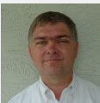


z/OS DFSMS Exploitation of Watson Assistant (WA)
February 4th, 2019 – Draft 3
Trinh Nguyen - Kevin Miner - Camvu Pham
Supporting Manager: Mauricio Adames

Slide 2

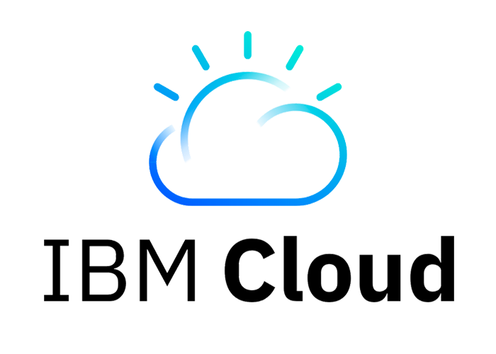
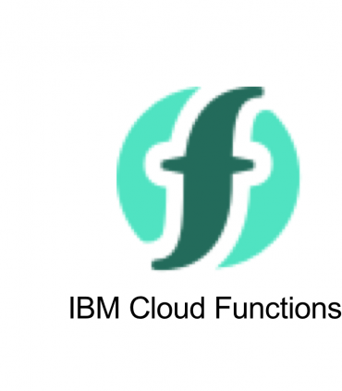
How Device Services will use Watson Assistant to Increase Productivity
Exploitation
The backbone
Plans
Further plans
Summarize goal
Demo
Questions & Answers
Introduction
Design Thinking

Slide 3

How Device Services will use Watson Assistant to Increase Productivity
How we started down this path…
Our journey into using IBM Watson Assistant begin with an entry in a [IBM Connections] Weekly Newsletter from CSTL announcing the availability of a chat bot interface to query SMPE maintenance.
Followed by a WebEx chat with CSTL
We were hooked on the idea of using Watson Assistant.
Watson Assistant is a platform that allows developers
and non-technical users to collaborate on building conversational AI-powered assistants.
Notes:
IBM Watson Assistant is an app or a tool and like any other app or tool it is pointless and actually counter productive to use if it does not truly help the users of the tool.
Our journey into using IBM Watson Assistant begin with an entry in an IBM Weekly Newsletter from CSTL announcing the availability of a chat bot interface to query SMPE maintenance.
Our initial attempts to use their chatbot were unsuccessful yet we still had conversations with Min TK Cheng/China/IBM and Jia BJ Liu/China/IBM@IBMCN in September of 2018 to discuss further.

Slide 4




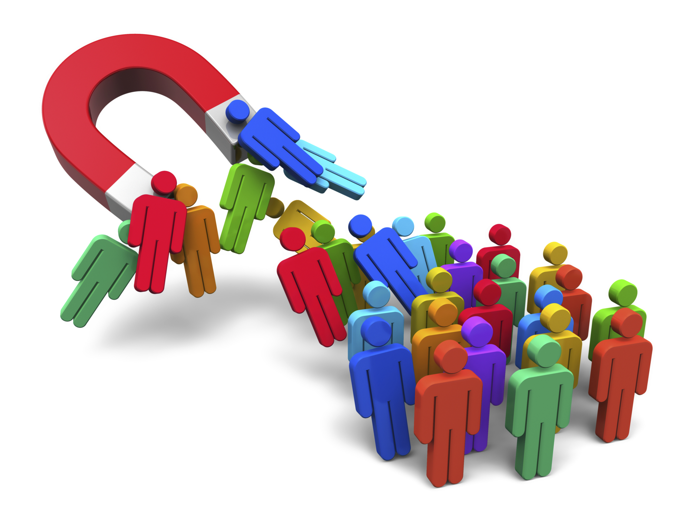
How Device Services will use Watson Assistant to Increase Productivity
How can Device Services change to help increase DFSMS productivity?
We need,
A process to SMPE install maintenance that is not tied to availability of a person or persons but rather tied to the person doing the work. This is extremely important in customer critical situations.
An automated process to assign native system resources to a tester or developer.
A process to update drivers on native systems that is not tied to availability of a person or persons.
Reduce the labor and time required to update native systems in Tucson.
A process to create regression test buckets where the resources being used are dynamic.
Allow a developer to run a test bucket with devices assigned for a unit test.
While a tester runs the same test bucket using different devices for regression.
An enticement or draw for new hires to want to work in DFSMS.

Slide 5

How Device Services will use Watson Assistant to Increase Productivity
Design Thinking perspective
1
HIGH
LOW
BIG BET
NO-BRAINER
A process to SMPE install maintenance that is not tied to availability of a person or persons but rather tied to the person doing the work.
An automated process to assign native system resources to a tester or developer.
A process to update drivers on native systems that is not tied to availability of a person or persons.
A process to create regression test buckets where the resources being used are dynamic.
An enticement or draw for new hires to want to work in DFSMS.
3
4
1
5
2
VALUE TO USERS
2
3
4
UN-WISE
UTILITIES
5
DIFFICULT/EXPENSIVE FEASIBILITY FOR US EASY/CHEAP
Prioritization Matrices

Slide 6
How Device Services will use Watson Assistant to Increase Productivity
Design Thinking perspective
Hill:
Developers and testers can use a tool built with Watson Assistant and other Cloud services to manage and operate DFSMS native systems with more automated processes and 60 to 90 percent of time saved per task.

Slide 7
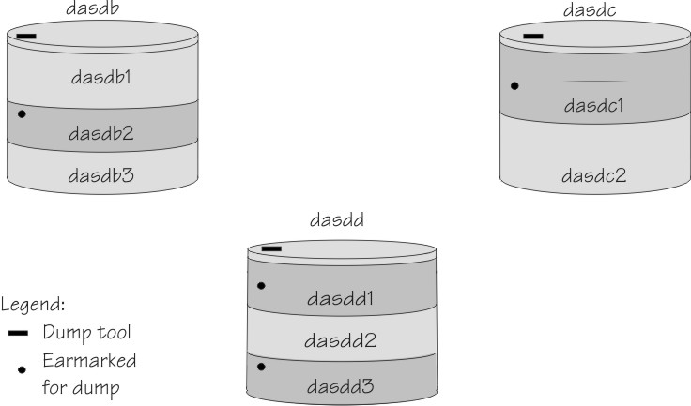
How Device Services will use Watson Assistant to Increase Productivity
In our exploitation of Watson Assistant where we will,
Give testers and developers the access to our 10 MESx native systems
Run a mix of R2.1 through R2.4 in three different sysplexes
Give user of these systems dedicated DASD and SMS storage pool resources
Change the systems to meet the requirements of our users
Recently added HyperSwap capability for zHyperlink development and test
R2.1 R2.2 R2.3 R2.4
MESx
MESx
MESx
. . . sysplex
MESx
MESx
. . . sysplex
MESx
MESx
MESx
MESx
. . . sysplex
Notes:
+ There are 10 native systems as part of this configuration spread across three sysplexes running a mix of R2.1 to R2.4
+ These 10 systems, the way they are configured and maintained coupled with our willingness and ability to change how we work are the keys to making IBM WA a useful tool for DFSMS.
+ Each user on these systems is giving dedicated devices and a unique SMS storage group.
+ The users of these native systems include DFSMS testers and developers, Level 2, other teams outside of DFSMS and even strategic IBM partners (TeraCloud).

Slide 8
How Device Services will use Watson Assistant to Increase Productivity
The Backbone of our use of Watson Assistant
is really batch jobs to,
Query SMPE maintenance, similar to CSTL
Install SMPE maintenance
IPL a native system, from the active IPL or a different IPL address (without access to the HMC)
Anyone access to our chatbot can perform these tasks.
Meaning any DFSMS developer can test the SMPE installation of maintenance before making it available
This could be a significant benefit in a critical customer situation.
The results of the SMPE work will be emailed to the user to provide historical reference, verified through W3 authentication.

Slide 9

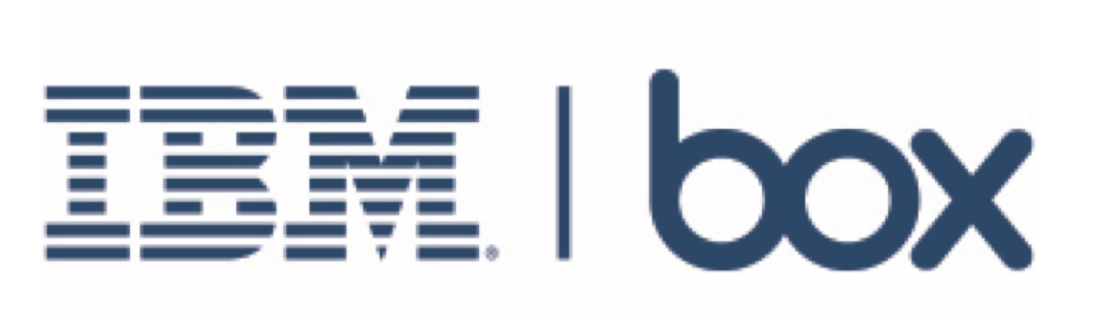

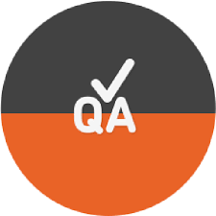
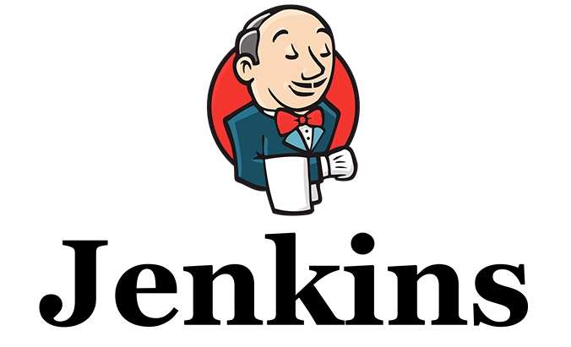



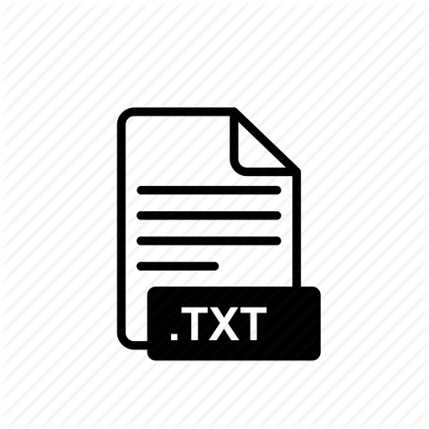

How Device Services will use Watson Assistant to Increase Productivity
Our plans for Watson Assistant is to use
this interface to,
Perform device and SMS storage group assignments
Past
Lotus Notes Database
Current
Excel spreadsheet in IBM Box
These spreadsheets use macros to find free or assigned devices.
Goal
Allow device and storage group assignments to be for the scope of a test and not permanently dedicated
Once we can dynamically change device assignments we can change how Device Services regression tests are generated, scheduled and run by tying this to JAT/Jenkins.
At this point developers could have access to up-to-date regression buckets for unit testing.
Notes:
One of our directions is to enhance the use of IBM Watson Assistant to perform the device and storage group assignments mentioned previously.
Device assignments used to be kept in a Lotus Notes database. Locating free or assigned devices was a tedious and time consuming effort.
Device assignments have now been moved in spreadsheets stored in IBM Box with macros added to search and display free or device assignment by user name.
We are currently looking at moving these from IBM Box to GitHub with the idea being that storing in GitHub will allow us access from one of our MESx native systems.
When we can access device assignment spreadsheets from a native system we can query or alter these assignments.
Once we can query device assignments from a native system developers and testers acquire and return devices as needed.
Once we can do the device assignments we will change how regression test cases are generated, currently an ISPF dialog, to use user specified devices.
The next step will be to take these test cases generated with the user specified devices and have JAT/Jenkins run and monitor these tests.

Slide 10
Other plans we have for Watson Assistant,
How Device Services will use Watson Assistant to Increase Productivity
Change the way we update our native systems when Driver Build provides an updated driver.
Currently we use ISPF dialogs and JCL skeletons to generate JCL to copy an updated driver.
Which generates a series of jobs we run on an EC machine, z/OS guest under VM, and the target native system.
These jobs are run by a self-contained job scheduler, a REXX exec that uses the SDSF REXX interface, which submits each job in series.
Additional jobs are required to reinstall additional maintenance we have not on the driver.
We are working on an interface that will allow these jobs to be generated by a Watson Assistant chatbot command that invokes a job or task run on a native systems and automate missing maintenance reinstallation.
Once we figure out how to automate bringing up an EC machine and start the required jobs, updating a native system in end to end automation could be invoked by Watson Assistant.
This doesn’t sound like a big deal for our 10 systems but Jeff Watson who reports to Naomi Htoo-Mosher is tasked with maintaining over 100 systems in the Tucson data center.
Jeff is already using our driver copy process for their systems in Guadalajara, Mexico.
Notes:
Another direction in which we intend to exploit IBM WA is the process we use to update the operating systems, drivers, on our native systems.
Currently we use an ISPF dialog to generate JCL to copy drivers from our Driver Build team.
This JCL is a series of batch jobs, some run on a z/OS guest under VM and some on run on a native system.
These jobs are run by a self-contained job scheduler, a rexx exec that exploits the SDSF interface, so one job is run on the VM guest and one on the native side.
Additional jobs are required to reinstall additional maintenance we have not on the driver but we are working on automating this also.
We are currently working to add an interface that would allow the JCL to be generated from a batch job run on a MESx native system. (Any batch job we can run IBM WA can run.)
Once we figure out how to run kick off bringing up an z/OS guest we can automate this end to end with an IBM WA chatbot.
This may not sound like a big deal for our 10 systems but Jeff Watson who reports to Naomi Htoo-Mosher is tasked with maintaining over 100 systems in the Tucson data center.
Jeff's goal is to reconfigure his systems to emulate our MESx systems and use our same driver copy proces.
This has already been done for three systems in Guadalajara Mexico.

Slide 11
How Device Services will use Watson Assistant to Increase Productivity
To summarize our goal,
Use IBM WA to change the way we maintain, update, IPL and test on the DFSMS native systems
The positives:
Much of this will use Javascript with Cloud services and should be interesting to new hires.
Gives developers and testers access to native systems running with multiple releases using the latest processors and real DASD, that they can provision, where they the user can alter and IPL when it fits their schedule or timeline.
The MESx system configuration and maintenance processes can easily be changed as we own all the parts.
Generating and initiating regression testing from a chatbot expands the resources available to developers without increasing their workload.
Being able to do an SMPE install and IPL a z/OS native system from a IBM Watson Assistant chatbot is pretty cool.
Notes:
To summarize our goal is to use IBM WA to change the way we maintain, update, IPL and test on the DFSMS native systems.
The positives
Much of this will use javascript in Node.js environment and should be interesting to new hires.
Gives developers and testers access to native systems running with multiple releases using the latest processors and real DASD, that they can provision, where they the user can alter and IPL when it fits their schedule or timeline.
A significant portion of the tasks being completed are done in batch so there is history and documentation.
The MESx system configuration and maintenance processes can easily be changed as we own all the parts.
Generating and initiating regression testing from a chatbot expands the resources available to developers without increasing their workload.
Being able to do an SMPE install and IPL a z/OS native system from a IBM Watson Assistant chatbot is pretty cool.

Slide 12
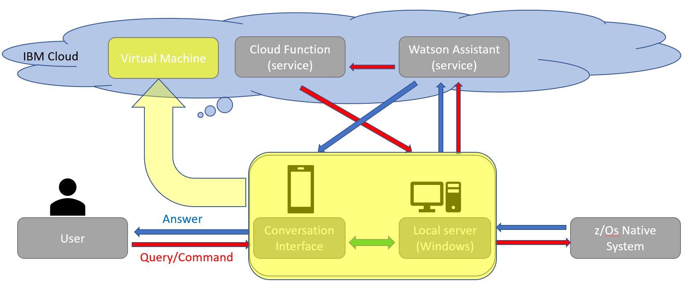
How Device Services will use Watson Assistant to Increase Productivity
Roadblocks to exploiting the Device Services Native Systems,
z/OS is a complicated platform and we have done a lot of behind the scenes work in the configuration and maintenance process to make this possible. When this breaks someone has to go into the abyss and put it back together.
Currently, the tool is published via the access to a physical local workstation working as a server.
This machine needs to be up with our app running for the tool to be accessible.
The performance of the tool has to take impact from the connection quality on the local workstation.
Only one tool builder can work on this workstation. Merging the work of other contributors in building, maintaining and fixing problems with the tool has to depend on the work of the local workstation owner.
There are potential security problems in giving access to local mobile workstation.
Solution: A virtual machine can be provisioned by Cloud service
and designated to be the server for the Watson bot tool, where all
the tool developers can log in and work on the app.

Slide 13
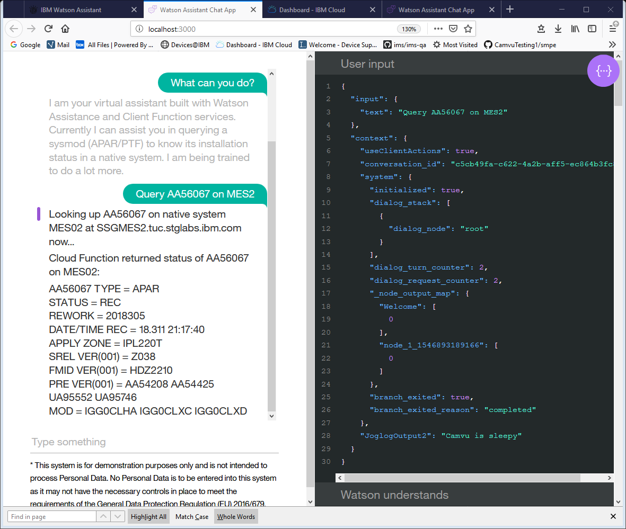

How Device Services will use Watson Assistant to Increase Productivity
Demo
Snapshots
Flow
Action
Chatbot interface
Console window on Window PowerShell
Dialog settings in Watson Assistant Skill
Client Action code in Node.js
Project repository

Slide 14
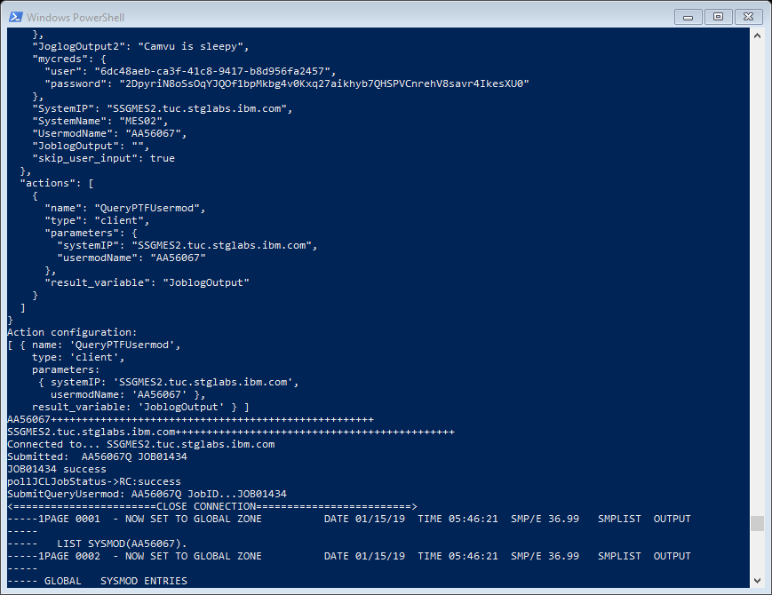
How Device Services will use Watson Assistant to Increase Productivity
Demo
Snapshots
Flow
Action
Chatbot interface
Console window on Window PowerShell
Dialog settings in Watson Assistant Skill
Client Action code in Node.js
Project repository

Slide 15
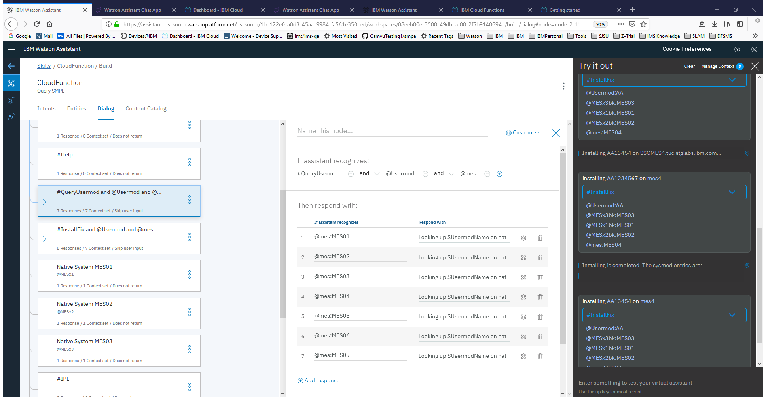
How Device Services will use Watson Assistant to Increase Productivity
Demo
Snapshots
Flow
Action
Chatbot interface
Console window on Window PowerShell
Dialog settings in Watson Assistant Skill
Client Action code in Node.js
Project repository

Slide 16
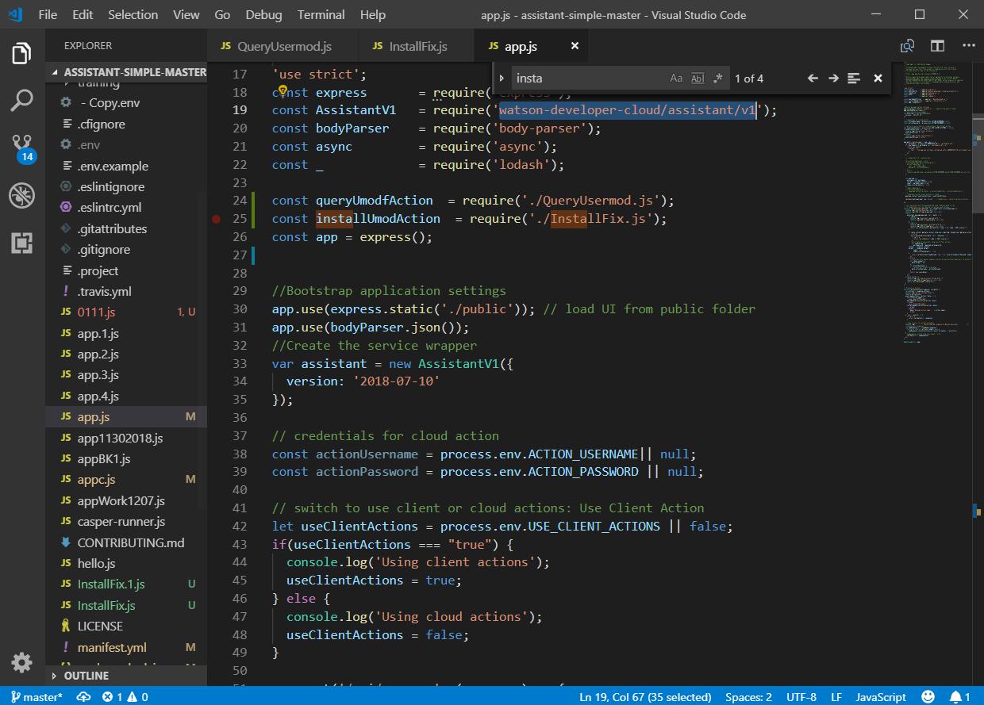
How Device Services will use Watson Assistant to Increase Productivity
Demo
Snapshots
Flow
Action
Chatbot interface
Console window on Window PowerShell
Dialog settings in Watson Assistant Skill
Client Action code in Node.js
Project repository

Slide 17
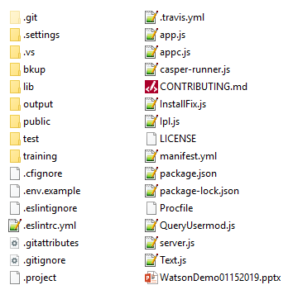
How Device Services will use Watson Assistant to Increase Productivity
Demo
Snapshots
Flow
Action
Chatbot interface
https://github.ibm.com/dfsms-devicesupport/watson-zos
Console window on Window PowerShell
Dialog settings in Watson Assistant Skill
Client Action code in Node.js
Project repository

Slide 18
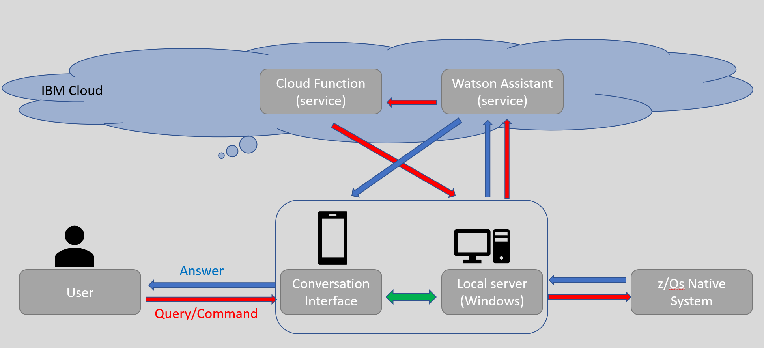
How Device Services will use Watson Assistant to Increase Productivity
Demo
Snapshots
Flow
Action
Chatbot interface
Console window on Window PowerShell
Dialog settings in Watson Assistant Skill
Client Action code in Node.js
Project repository

Slide 19
How Device Services will use Watson Assistant to Increase Productivity
Demo
Snapshots
Flow
Action
Chatbot interface
Console window on Window PowerShell
Dialog settings in Watson Assistant Skill
Open Window PowerShell or Command Prompt
Change directory to directory path of assistant-simple-master
Command: npm start
Open web browser, go to localhost:3000/
Talk to the Watson bot
Client Action code in Node.js
Project repository

Slide 20


How Device Services will use Watson Assistant to Increase Productivity
Question and Answers

Slide 21
January 29, 2018 – Draft 2
Supporting Manager: Mauricio Adames
Trinh Nguyen - Kevin Miner - Camvu Pham
Thank You!

